Slide 1
Sovereign and Municipal Debt Restructuring:
Legal Frameworks, Risks, Reforms, and the Public Interest
June 8, 2025

Slide 2
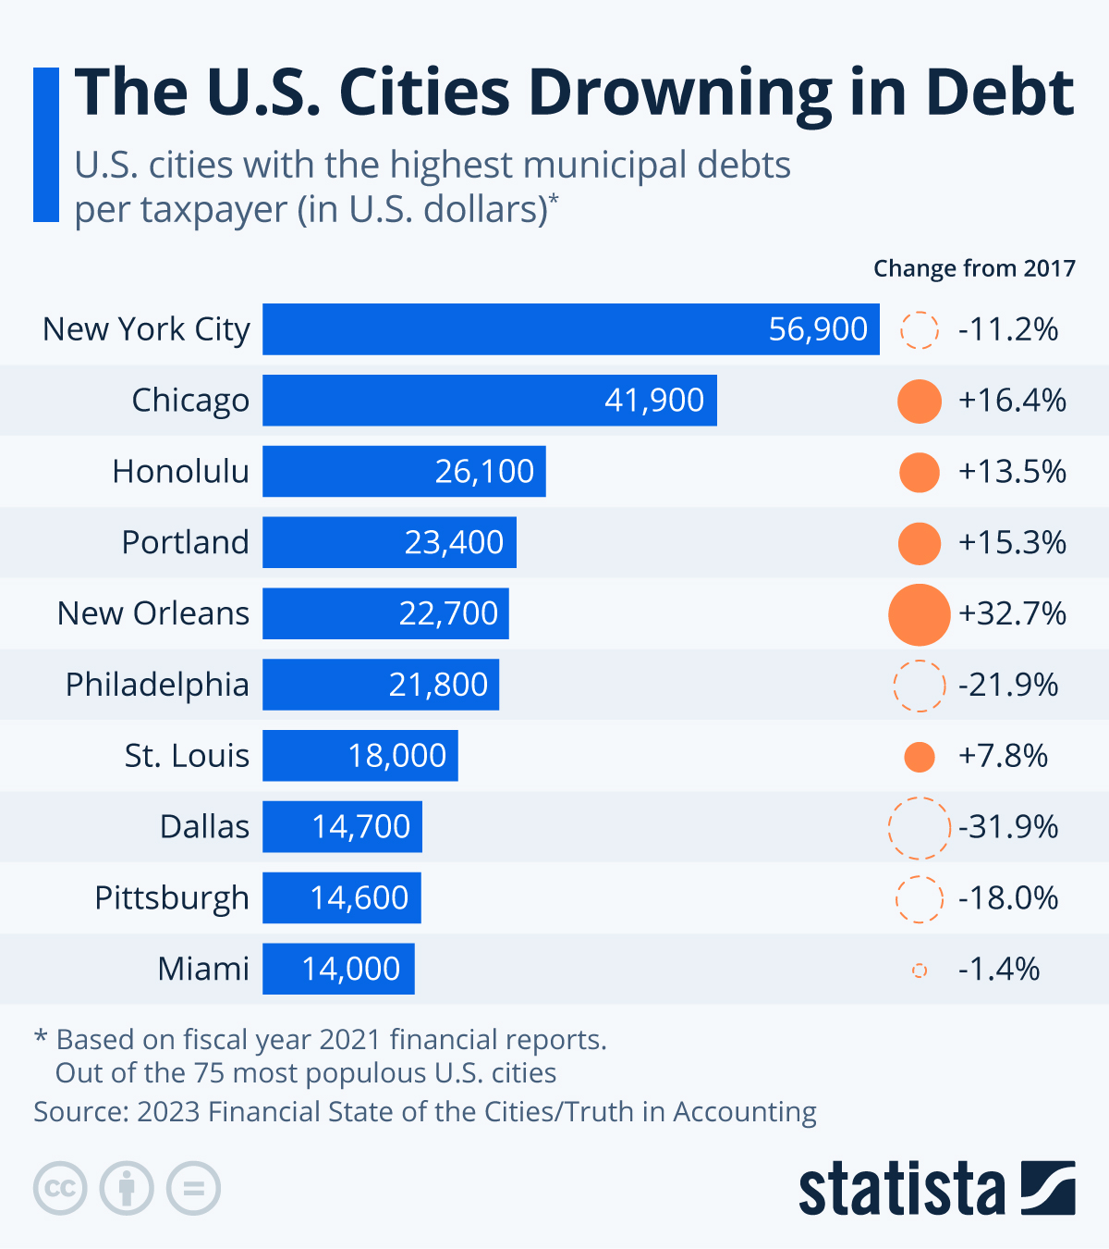
Municipal Restructurings (1)
Municipal restructurings:
Definition and Scope
Importance/Relevance
Pre-emptive restructuring mechanisms:
Definition
Case studies: Canada and Japan

Slide 3
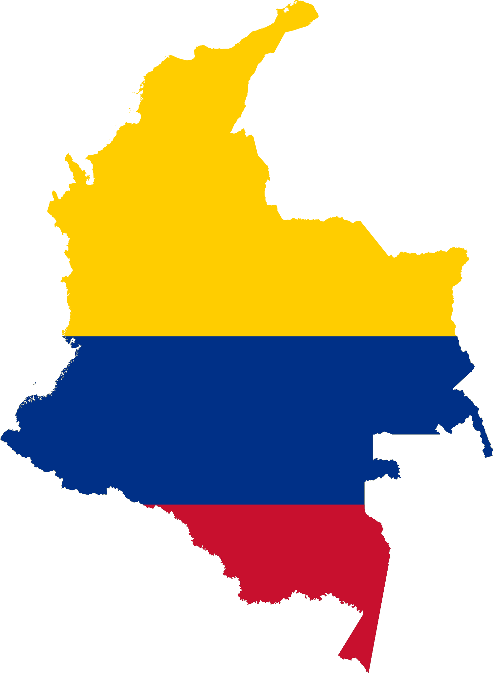
Municipal Restructurings (2)
United States
Colombia
United Kingdom

Slide 4
Zambia: Sovereign Restructuring and China's Role
Zambia defaulted in 2020, driven by falling copper prices, COVID-19, and increased external borrowing.
By 2022, Zambia's sovereign debt exceeded $14.8B; nearly one-third owed to Chinese lenders.
China’s bilateral lending features confidentiality clauses and limited transparency, complicating multilateral coordination.
Zambia pursued debt treatment under the G20 Common Framework, co-chaired by China and France.
China participates selectively in debt relief efforts but remains outside the Paris Club.
Confidential terms in Chinese loans may inhibit restructuring via other platforms and democratic oversight.
Zambia’s debt crisis reduced fiscal capacity for health and education; debt restructuring outcomes affect public welfare.
Concerns over ‘debt-trap diplomacy’ persist despite inconclusive evidence; transparency and accountability remain key issues.

Slide 5
Sovereign Debt Restructuring in Latin America
Latin America pioneered contractual restructuring tools—Collective Action Clauses (CACs)—after Argentina's 2001 default.
CACs allow a supermajority to bind all bondholders, reducing holdout risk; standard in sovereign and corporate bonds today.
Argentina’s GDP bonds triggered litigation in UK courts over rebased GDP metrics affecting 2013 payments.
Judge Picken ruled Argentina owed payments based on outdated GDP data; decision remains under appeal. Obstacle for new debt raising.
In the YPF case, plaintiffs claim expropriation triggered a tender offer obligation; US court awarded $16.1B judgment. Liability included in IMF recent loan facility to Argentina. Impact on potential negotiations.
Litigation-financed claims raise concerns about judicial reach and potential to disrupt sovereign debt management.

Slide 6
Greece: The Public and Private Dimension of Debt-Restructuring
Greece has historically relied heavily on external debt and has a long history of sovereign debt defaults.
The recent debt crisis stemmed from long-standing external borrowing to fund high budget deficits- debt peaked at €310B (120% of GDP) in 2009.
The crisis threatened the European financial system and could potentially trigger a domino effect in other Euro area Member States.
The initial response was a massive bailout, which however failed, making debt restructuring necessary to restore sustainability and investor confidence.
Restructuring was conditional on high participation and included retrofitted CACs in Greek-law bonds- Final agreement restructured €205B in debt, achieving €108B reduction (52%).
Debt shifted from private to public institutions like EFSF and ESM, changing risk profile of Greek sovereign debt.
Eurozone now mandates CACs in sovereign bonds; ESM offers structured bailout response.
Greek case highlighted need for combining legal tools with political coordination to maintain monetary union stability.

Slide 7
Conclusions
Municipal and sovereign restructurings differ in process but share goals: maintaining services and public trust.
UK relies on administrative intervention (e.g., Section 114), while US courts manage municipal bankruptcies under Chapter 9.
Zambia’s case underscores the challenge of opaque bilateral debt in restructuring frameworks.
Argentina's court cases highlight legal uncertainty even in supposedly resolved defaults.
Legal frameworks must evolve to equitably distribute restructuring burdens and enhance creditor coordination.
Transparency and data consistency are crucial to avoid delays, enhance confidence, and protect public services.
Governments should prioritize resilient fiscal strategies and consider debt sustainability in all future borrowing.
Cross-border legal interpretations (e.g., YPF case) may redefine sovereign creditor risks in global markets.

